Slide 1
Database-ics
An Introduction to SQL for R Users
Chloe Brook

Slide 2
What are we going to do today?
SQL: what is it and why use it?
Basic SQL statements
Using SQL and R together

Slide 3
Things to set up
Install SQLite Browser: https://sqlitebrowser.org/dl/
Can use this to play with SQL in your own time, if you don’t get it working today
Once installed, open the ‘rladies_march24.db’ file
Install Tidyverse R package: should cover most bases today!
Download files from Github repo: https://github.com/chloearielle/RLadiesMarch24/

Slide 4
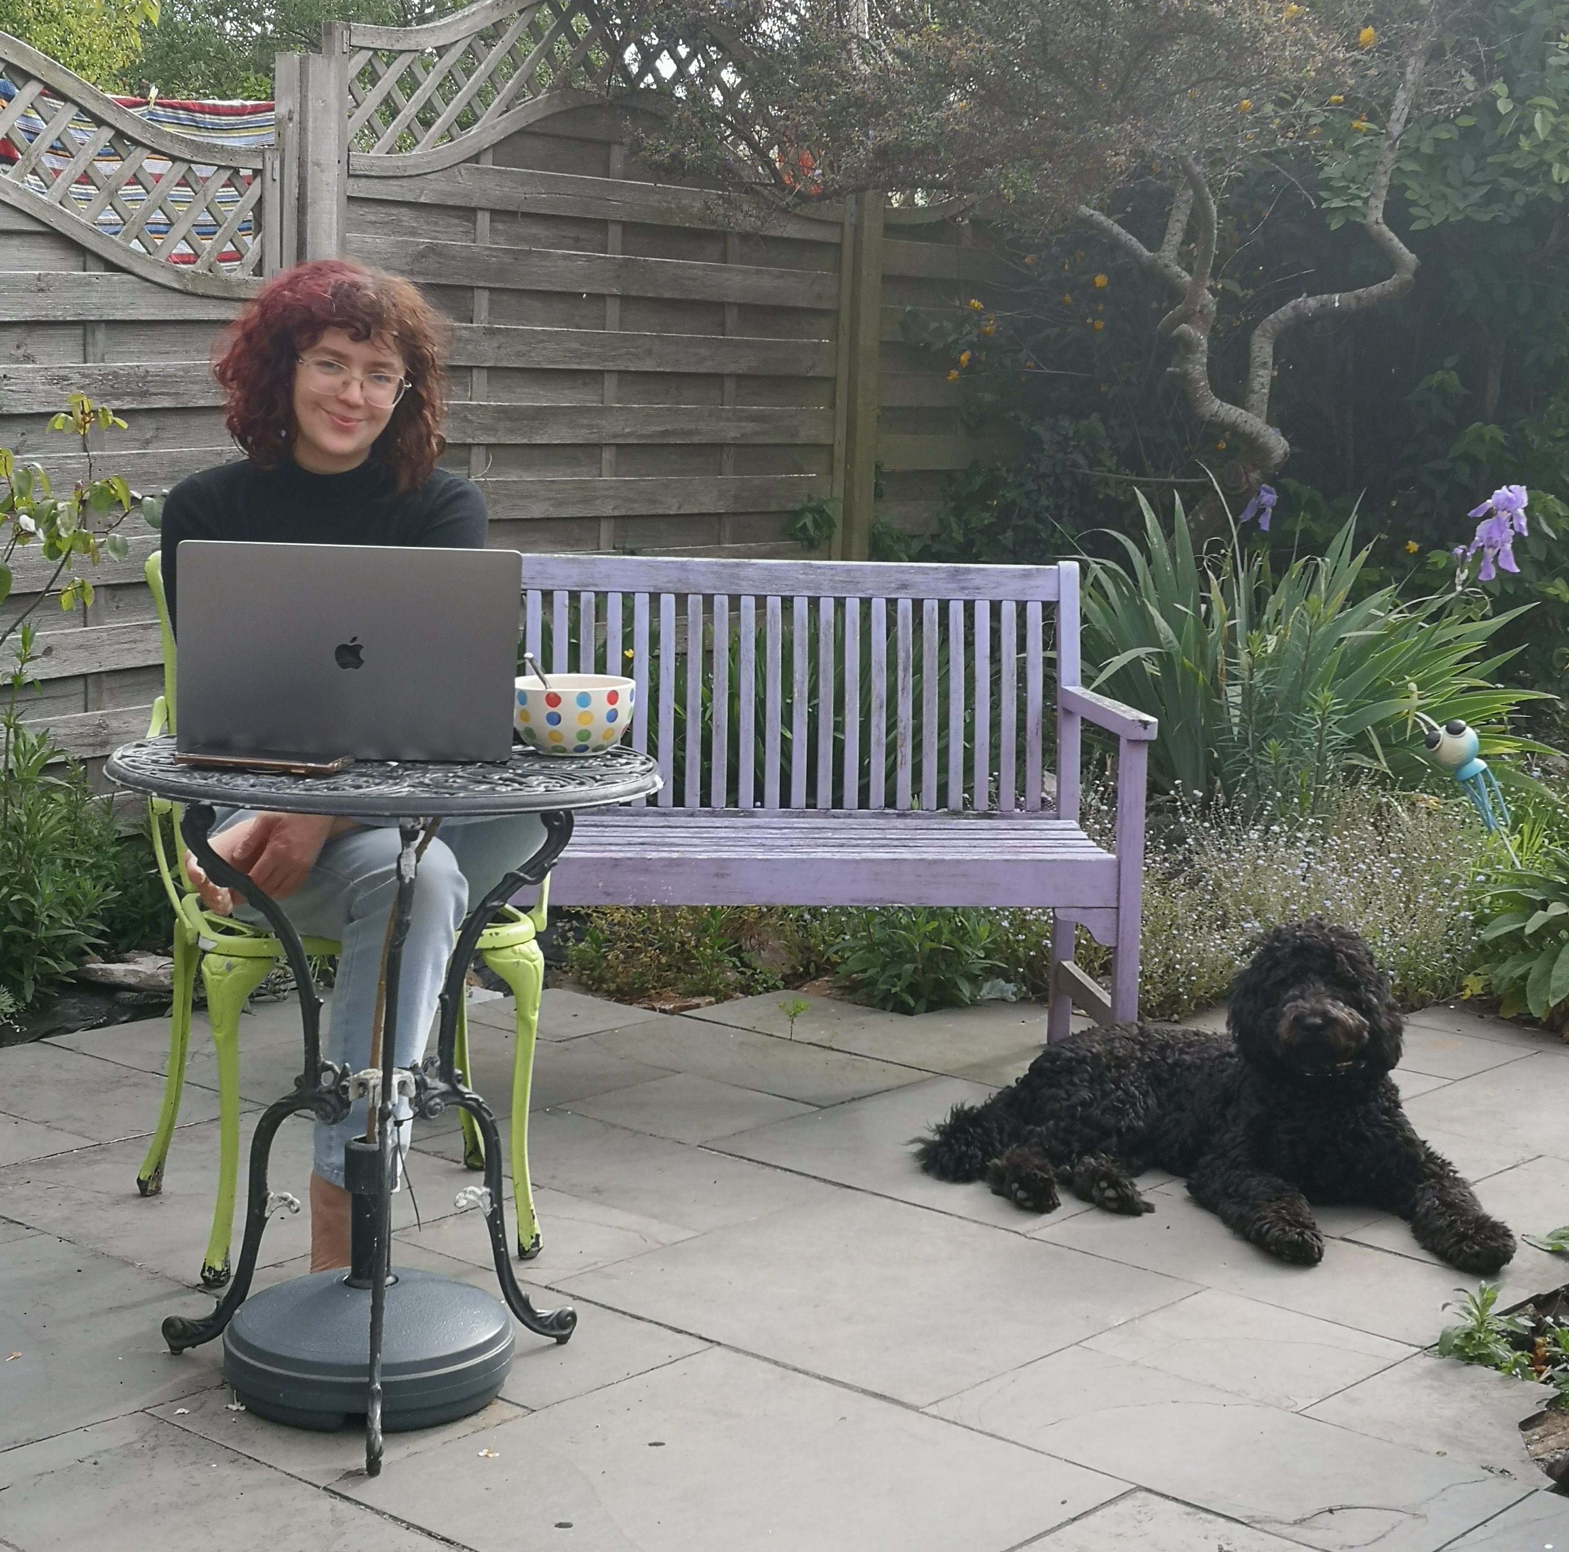
My Background
Not a computer scientist: studied Biochemistry at undergraduate, MSc project focused on bioinformatics, fell in LOVE
EPCC 2020 – present: using SQL and R across multiple projects, mainly working with NHS data in DataLoch.
Also an online maths and science tutor since 2020 – I love teaching things!

Slide 5
My Background
Not a computer scientist: studied Biochemistry at undergraduate, MSc project focused on bioinformatics, fell in LOVE
EPCC 2020 – present: using SQL and R across multiple projects, mainly working with NHS data in DataLoch.
Also an online maths and science tutor since 2020 – I love teaching things!
Enough about me…on to the data!

Slide 6

Our data for today…
Notes:
I downloaded my ENTIRE Spotify listening history (in early 2023, so unfortunately I don’t have the last year yet…) and I’ve put it here for you to play with!

Slide 7
Our data for today…
Listens
spotify_track_uri | timestamp | ms_played | conn_country | shuffle | skipped
spotify:track:1FLxW6LI6PZK8InYyYFULw | 2014-04-27T10:33:56Z | 230106 | GB | FALSE | FALSE
spotify:track:4RvWPyQ5RL0ao9LPZeSouE | 2020-12-15T17:33:22Z | 251262 | GB | FALSE | NA
spotify:track:2OQpQTRogZ1AhnUHJiT9Nb | 2020-07-29T12:17:32Z | 153463 | GB | FALSE | NA
spotify:track:2pDKE8Q40TDGPl1O11DKKn | 2022-08-28T09:45:05Z | 8046 | GB | FALSE | NA
spotify:track:735rjks7kQgWCjTQlIHMuH | 2020-11-13T15:29:47Z | 768 | GB | FALSE | NA
Songs
song_name | artist_name | album_name | spotify_track_uri
Malibu | Hole | Celebrity Skin | spotify:track:1FLxW6LI6PZK8InYyYFULw
Everybody Wants To Rule The World | Tears For Fears | Songs From The Big Chair | spotify:track:4RvWPyQ5RL0ao9LPZeSouE
Heavy Balloon | Fiona Apple | Fetch The Bolt Cutters | spotify:track:2OQpQTRogZ1AhnUHJiT9Nb
Shameika | Fiona Apple | Fetch The Bolt Cutters | spotify:track:2pDKE8Q40TDGPl1O11DKKn
Head over Feet - 2015 Remaster | Alanis Morissette | Jagged Little Pill | spotify:track:735rjks7kQgWCjTQlIHMuH
Notes:
I’ve created a simple database in the ‘rladies_march24.db’ file, containing two tables: listens and songs. Explain a little bit about how each row represents a listen in ‘listens’ and each row in ‘songs’ represents a song

Slide 8
What is SQL?
SQL stands for Structured Query Language
It is used to query relational databases
Each table is called a relation
Different tables (relations) can be joined together using keys
There are many different ‘flavours’ of SQL
Open-source: PostgreSQL, MySQL, SQLite…
Commercial: Oracle, Microsoft Server SQL (MSSQL)…
Notes:
https://www.nobledesktop.com/learn/sql/the-many-flavors-of-sql-a-guide-to-relational-databases

Slide 9
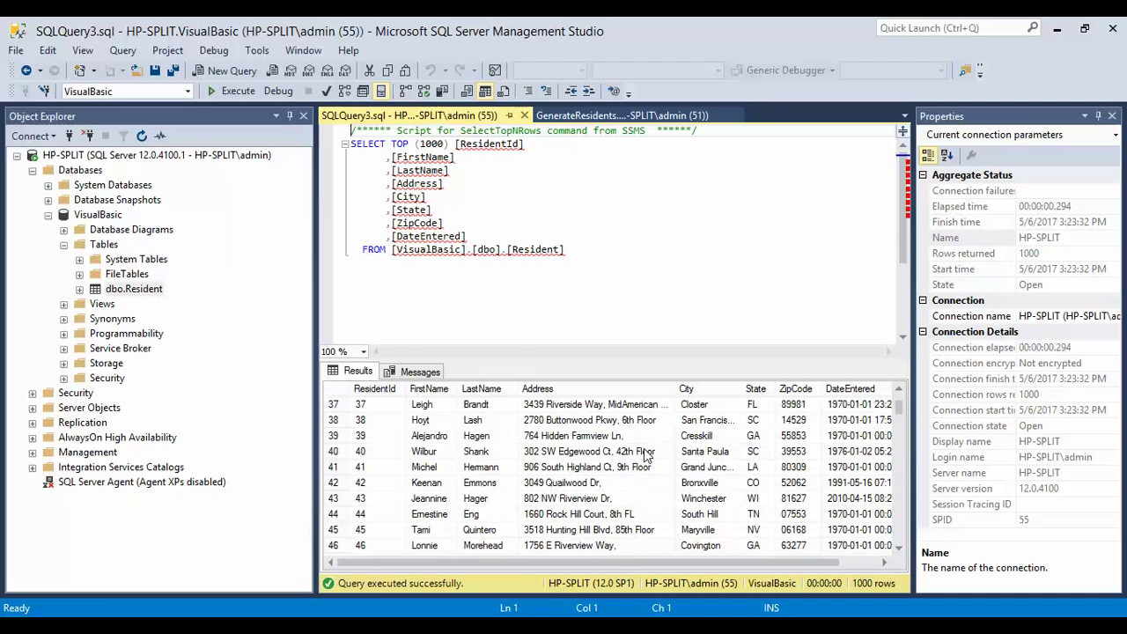
What is SQL?
Notes:
I mainly use MSSQL in my work

Slide 10
What is SQL?
Notes:
https://www.nobledesktop.com/learn/sql/the-many-flavors-of-sql-a-guide-to-relational-databases

Slide 11
Why use SQL?
Allows us to efficiently access, filter and tidy big data stored within databases
Can look at data without modifying underlying tables
Intuitive to learn and to read
Notes:
Talk a bit about how I use it in my daily work

Slide 12
Why use SQL?
Allows us to efficiently access, filter and tidy big data stored within databases
Can look at data without modifying underlying tables
Intuitive to learn and to read
Notes:
Talk a bit about how I use it in my daily work

Slide 13
Let’s build a basic SQL query!
SELECT *
FROM songs
LIMIT 10;
Notes:
This uses the wildcard symbol (*) to select all columns from the table ‘songs’. Because this is a large table and we don’t want to retrieve all of the rows, we use the ‘LIMIT 10’ statement to only select ten rows. This number can be changed!

Slide 14
Let’s build a basic SQL query!
SELECT song_name, artist_name, album_name
FROM songs
LIMIT 100;
Notes:
Column names can be specified, rather than picking out all columns. This songs table is nice, but when did I listen to these songs? To find this, we need to join the LISTENS table, using the spotify_track_uri as the key

Slide 15
Let’s join these tables together!
Listens
spotify_track_uri | timestamp | ms_played | conn_country | shuffle | skipped
spotify:track:1FLxW6LI6PZK8InYyYFULw | 2014-04-27T10:33:56Z | 230106 | GB | FALSE | FALSE
spotify:track:4RvWPyQ5RL0ao9LPZeSouE | 2020-12-15T17:33:22Z | 251262 | GB | FALSE | NA
spotify:track:2OQpQTRogZ1AhnUHJiT9Nb | 2020-07-29T12:17:32Z | 153463 | GB | FALSE | NA
spotify:track:2pDKE8Q40TDGPl1O11DKKn | 2022-08-28T09:45:05Z | 8046 | GB | FALSE | NA
spotify:track:735rjks7kQgWCjTQlIHMuH | 2020-11-13T15:29:47Z | 768 | GB | FALSE | NA
Songs
song_name | artist_name | album_name | spotify_track_uri
Malibu | Hole | Celebrity Skin | spotify:track:1FLxW6LI6PZK8InYyYFULw
Everybody Wants To Rule The World | Tears For Fears | Songs From The Big Chair | spotify:track:4RvWPyQ5RL0ao9LPZeSouE
Heavy Balloon | Fiona Apple | Fetch The Bolt Cutters | spotify:track:2OQpQTRogZ1AhnUHJiT9Nb
Shameika | Fiona Apple | Fetch The Bolt Cutters | spotify:track:2pDKE8Q40TDGPl1O11DKKn
Head over Feet - 2015 Remaster | Alanis Morissette | Jagged Little Pill | spotify:track:735rjks7kQgWCjTQlIHMuH
Notes:
These tables can be joined on the column ‘spotify_track_uri’. This is the primary key of the Songs table, which means it is a unique identifier for each row of the Songs table.

Slide 16
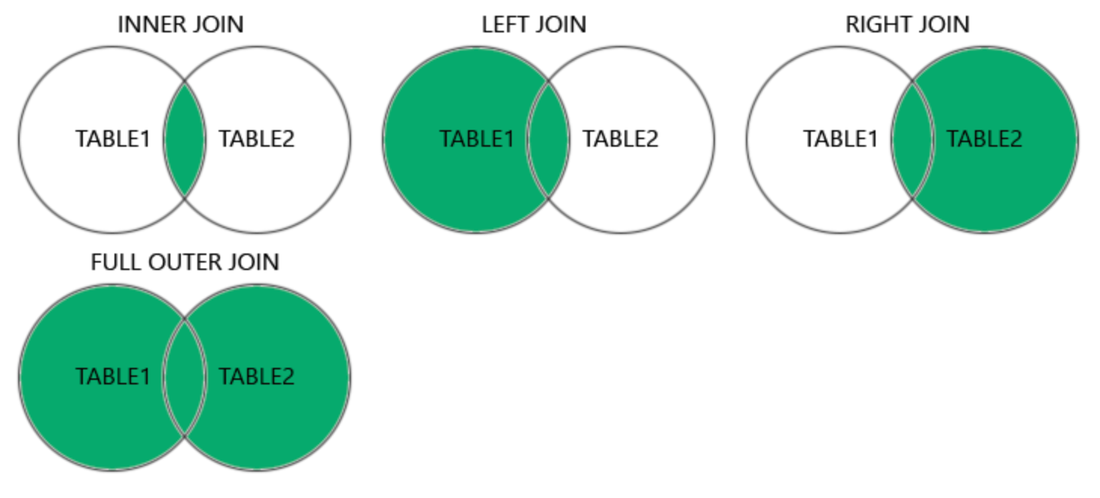
A quick overview of joining
Taken from https://www.w3schools.com/sql/sql_join.asp

Slide 17
Let’s keep building a basic SQL query!
SELECT song_name, artist_name, album_name, timestamp
FROM songs
INNER JOIN listens ON listens.spotify_track_uri = songs.spotify_track_uri
LIMIT 100;
Notes:
We use INNER JOIN

Slide 18
Let’s keep building a basic SQL query!
SELECT song_name, artist_name, album_name, timestamp
FROM songs s
INNER JOIN listens l ON l.spotify_track_uri = s.spotify_track_uri
LIMIT 100;
Notes:
We can use an alias to make our scripts a bit easier to read and write

Slide 19
Let’s keep building a basic SQL query!
SELECT song_name, artist_name, album_name, timestamp
FROM songs s
INNER JOIN listens l ON l.spotify_track_uri = s.spotify_track_uri
ORDER BY timestamp DESC
LIMIT 100;
Notes:
We can specify the order of the rows in our table, in this case ordering by timestamp. DESC is used to specify descending order, SQL will default to ascending order if this is not specified.

Slide 20
Our final SQL query (for now…)
SELECT song_name, artist_name, album_name, timestamp
FROM songs s
INNER JOIN listens l ON l.spotify_track_uri = s.spotify_track_uri
WHERE artist_name = 'David Bowie'
ORDER BY timestamp DESC
LIMIT 100;
Notes:
We can filter the rows of a table based on a condition, in this case we filter on the artist_name column to show all of my listens to David Bowie

Slide 21
Side by side with R dplyr code
SQL R
SELECT song_name, artist_name, album_name, timestamp
FROM songs s
INNER JOIN listens l ON l.spotify_track_uri = s.spotify_track_uri
WHERE artist_name = 'David Bowie'
ORDER BY timestamp DESC
LIMIT 100;
songs %>%
inner_join(listens) %>%
select(song_name, artist_name, album_name, timestamp) %>%
filter(artist_name == "David Bowie") %>%
arrange(-timestamp) %>%
head(n = 100)

Slide 22
Side by side with R dplyr code
SQL R
SELECT song_name, artist_name, album_name, timestamp
FROM songs s
INNER JOIN listens l ON l.spotify_track_uri = s.spotify_track_uri
WHERE artist_name = 'David Bowie'
ORDER BY timestamp DESC
LIMIT 100;
songs %>%
inner_join(listens) %>%
select(song_name, artist_name, album_name, timestamp) %>%
filter(artist_name == "David Bowie") %>%
arrange(-timestamp) %>%
head(n = 100)

Slide 23
Side by side with R dplyr code
SQL R
SELECT song_name, artist_name, album_name, timestamp
FROM songs s
INNER JOIN listens l ON l.spotify_track_uri = s.spotify_track_uri
WHERE artist_name = 'David Bowie'
ORDER BY timestamp DESC
LIMIT 100;
songs %>%
inner_join(listens) %>%
select(song_name, artist_name, album_name, timestamp) %>%
filter(artist_name == "David Bowie") %>%
arrange(-timestamp) %>%
head(n = 100)

Slide 24
Side by side with R dplyr code
SQL R
SELECT song_name, artist_name, album_name, timestamp
FROM songs s
INNER JOIN listens l ON l.spotify_track_uri = s.spotify_track_uri
WHERE artist_name = 'David Bowie'
ORDER BY timestamp DESC
LIMIT 100;
songs %>%
inner_join(listens) %>%
select(song_name, artist_name, album_name, timestamp) %>%
filter(artist_name == "David Bowie") %>%
arrange(-timestamp) %>%
head(n = 100)

Slide 25
Side by side with R dplyr code
SQL R
SELECT song_name, artist_name, album_name, timestamp
FROM songs s
INNER JOIN listens l ON l.spotify_track_uri = s.spotify_track_uri
WHERE artist_name = 'David Bowie'
ORDER BY timestamp DESC
LIMIT 100;
songs %>%
inner_join(listens) %>%
select(song_name, artist_name, album_name, timestamp) %>%
filter(artist_name == "David Bowie") %>%
arrange(-timestamp) %>%
head(n = 100)

Slide 26
Side by side with R dplyr code
SQL R
SELECT song_name, artist_name, album_name, timestamp
FROM songs s
INNER JOIN listens l ON l.spotify_track_uri = s.spotify_track_uri
WHERE artist_name = 'David Bowie'
ORDER BY timestamp DESC
LIMIT 100;
songs %>%
inner_join(listens) %>%
select(song_name, artist_name, album_name, timestamp) %>%
filter(artist_name == "David Bowie") %>%
arrange(-timestamp) %>%
head(n = 100)

Slide 27
Side by side with R dplyr code
SQL R
SELECT song_name, artist_name, album_name, timestamp
FROM songs s
INNER JOIN listens l ON l.spotify_track_uri = s.spotify_track_uri
WHERE artist_name = 'David Bowie'
ORDER BY timestamp DESC
LIMIT 100;
songs %>%
inner_join(listens) %>%
select(song_name, artist_name, album_name, timestamp) %>%
filter(artist_name == "David Bowie") %>%
arrange(-timestamp) %>%
head(n = 100)

Slide 28
Accessing SQL from R
Can connect to databases from within R
Pull subsets of full database tables into R as needed: saves memory
Can perform analyses in R using data direct from databases

Slide 29

The magic of dbplyr!
The dbplyr package allows us to access data from databases using dplyr syntax
The show_query() function shows how the dplyr code translates into SQL

Slide 30
Side by side with R dplyr code
SQL R
SELECT song_name, count(*)
FROM listens l
INNER JOIN songs s ON l.spotify_track_uri = s.spotify_track_uri
WHERE artist_name = 'David Bowie'
GROUP BY song_name
ORDER BY count(*) desc;
songs %>%
inner_join(listens) %>%
filter(artist_name == "David Bowie") %>%
count(song_name, sort = TRUE)

Slide 31
Writing SQL direct in R
dbGetQuery(db_conn,
"SELECT min(timestamp), max(timestamp)
FROM listens l
WHERE conn_country = 'AU’;”
)

Slide 32
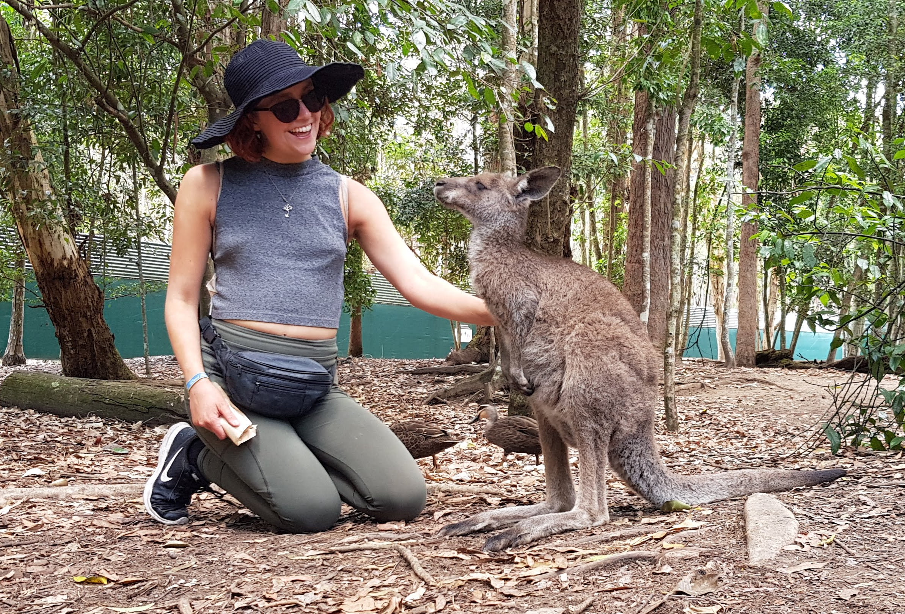
Writing SQL direct in R
dbGetQuery(db_conn,
"SELECT min(timestamp), max(timestamp)
FROM listens l
WHERE conn_country = 'AU’;”
)
RESULT:
min(timestamp) | max(timestamp)
2019-09-21T01:15:07Z | 2019-11-04T08:20:58Z

Slide 33
Thank you for listening everyone!

